Slide 1
Machine Learning -
Basic Principles & Practice
8. An Alternative Margin
机器学习 - 基础原理与实践
8. 别样的间距
Cong Li 李聪

Slide 2
Margin 间距
Margin in Linear Classifiers
线性分类器的间距
  Limit classification capability & improve accuracy 限制分类能力并提升准确率
    As a reflection of Occam’s Razor
    奥卡姆剃刀的一种呈现方式
Limitation 局限性
  Apply to linear classifiers only
  仅适用于线性分类器
    Distance from a sample to a hyperplane
    从一个数据点到超平面的距离

Slide 3
The Alternative 替代品
Alternative Definition of Margin
另一种间距的定义
  Apply to any regression function for classification 用于进行分类的回归函数
  Also as a reflection of Occam’s Razor
  也是奥卡姆剃刀的一种呈现方式
Here We Start from 这里我们始于
  Another type of linear classifier: logistic regression 另一种线性分类器：对数几率回归

Slide 4
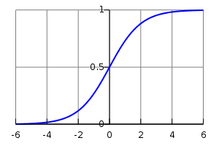

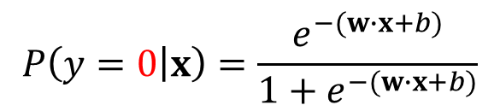

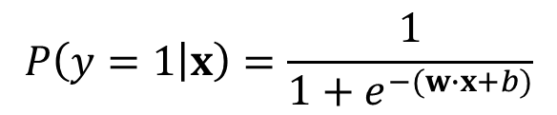

Logistic Regression
对数几率回归
Numerical function for probability estimation 用于概率估计的数值函数
Take the same explicit knowledge as linear classifier
使用和线性分类器一样的知识
$w$ & $b$
Output 0 or 1 for math elegance 输出0或1（以求数学上的优雅）
$$P\left(y=1 | x\right)=\frac{1}{1+e^{−(w∙x+b)}}$$
$$P\left(y=1 | x\right)$$
$$P\left(y=0 | x\right)=\frac{e^{−(w∙x+b)}}{1+e^{−(w∙x+b)}}$$
$$w∙x+b$$

Slide 5


Classification 分类
$$P\left(y=1 | x\right)$$
$$w∙x+b$$
$$P\left(y=1 | x\right)>0.5⟺P\left(y=0 | x\right)<0.5⟺w∙x+b>0$$
$$↓$$
$$y=1$$

Slide 6

Classification 分类
$$P\left(y=1 | x\right)$$
$$w∙x+b$$
$$P\left(y=1 | x\right)<0.5⟺P\left(y=0 | x\right)>0.5⟺w∙x+b<0$$
$$↓$$
$$y=0$$

Slide 7

Learning 学习
Given training data 给定训练数据
$$(x^{\left(1\right)},y^{\left(1\right)}),(x^{\left(2\right)},y^{\left(2\right)}),…,(x^{\left(m\right)},y^{\left(m\right)})$$
To estimate 估算出
$w$ & $b$
We start from the classical principle: maximum likelihood estimation
我们从经典法则开始：极大似然估计

Slide 8
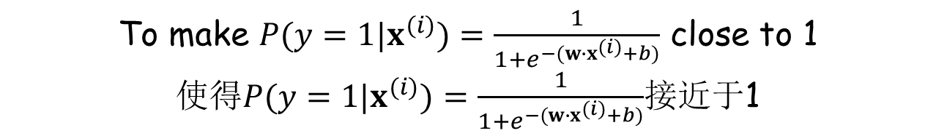
Maximum Likelihood Estimation
极大似然估计
Principle: we see the observations; we adjust the parameters to maximize the probability of the observations
原则：我们看到一些现象；我们调整参数，使得这些现象的概率尽可能地大
Say, e.g., we see $(x^{\left(i\right)},1)$ 比方说，我们看到$(x^{\left(i\right)},1)$
We adjust $w$ & $b$ 我们调整$w$和 $b$
To make $P(y=1|x^{(i)})=\frac{1}{1+e^{−(w∙x^{(i)}+b)}}$ close to 1
使得$P(y=1|x^{(i)})=\frac{1}{1+e^{−(w∙x^{(i)}+b)}}$接近于1

Slide 9
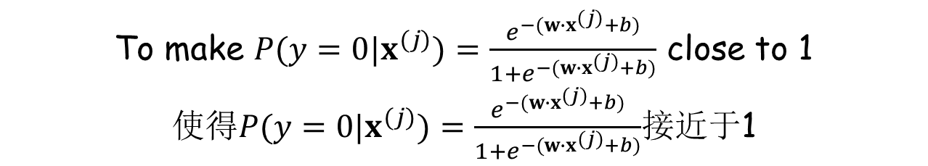
Maximum Likelihood Estimation
极大似然估计
Principle: we see the observations; we adjust the parameters to maximize the probability of the observations
原则：我们看到一些现象；我们调整参数，使得这些现象的概率尽可能地大
Say, e.g., we see $(x^{\left(j\right)},0)$ 比方说，我们看到$(x^{\left(j\right)},0)$
We adjust $w$ & $b$ 我们调整$w$和 $b$
To make $P(y=0|x^{(j)})=\frac{e^{−(w∙x^{(j)}+b)}}{1+e^{−(w∙x^{(j)}+b)}}$ close to 1
使得$P(y=0|x^{(j)})=\frac{e^{−(w∙x^{(j)}+b)}}{1+e^{−(w∙x^{(j)}+b)}}$接近于1

Slide 10

Maximum Likelihood Estimation
极大似然估计
Principle: we see the observations; we adjust the parameters to maximize the probability of the observations
原则：我们看到一些现象；我们调整参数，使得这些现象的概率尽可能地大
Now we see 现在我们看到
$$(x^{\left(1\right)},y^{\left(1\right)}),(x^{\left(2\right)},y^{\left(2\right)}),…,(x^{\left(m\right)},y^{\left(m\right)})$$
We adjust $w$ & $b$ 我们调整$w$和$b$
To make 使得
$$P(y^{\left(1\right)}|x^{\left(1\right)})×P(y^{\left(2\right)}|x^{\left(2\right)})×…×P(y^{\left(m\right)}|x^{\left(m\right)})$$
as large as possible 尽可能大

Slide 11
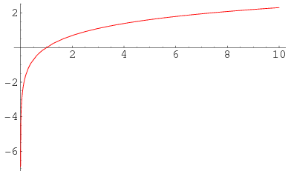



Transformation 变换
$$P(y^{\left(1\right)}|x^{\left(1\right)})×P(y^{\left(2\right)}|x^{\left(2\right)})×…×P(y^{\left(m\right)}|x^{\left(m\right)})$$
Can be very close to 0 given a large $m$
当$m$很大时可能会非常接近于0
We do a transformation using the logarithm function
我们用对数函数作一个变换
$$logp$$
$$p$$

Slide 12
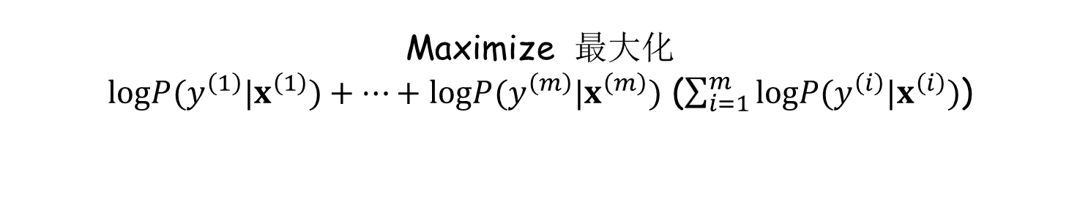
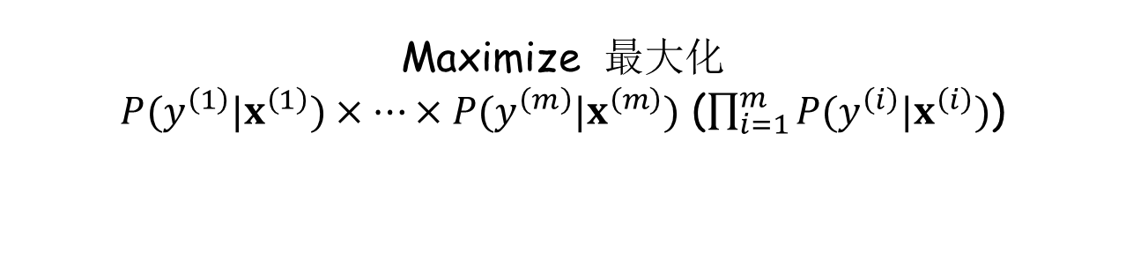
Transformation 变换
$$P(y^{\left(1\right)}|x^{\left(1\right)})×P(y^{\left(2\right)}|x^{\left(2\right)})×…×P(y^{\left(m\right)}|x^{\left(m\right)})$$
Can be very close to 0 given a large $m$
当$m$很大时可能会非常接近于0
We do a transformation using the logarithm function
我们用对数函数作一个变换
Maximize 最大化
$P(y^{\left(1\right)}|x^{\left(1\right)})×…×P(y^{\left(m\right)}|x^{\left(m\right)})$ ($\prod_{i=1}^{m}{P(y^{\left(i\right)}|x^{\left(i\right)})}$)
Equivalent to 等价于
Maximize 最大化
$logP(y^{\left(1\right)}|x^{\left(1\right)})+…+logP(y^{\left(m\right)}|x^{\left(m\right)})$ ($\sum_{i=1}^{m}{logP(y^{\left(i\right)}|x^{\left(i\right)})}$)

Slide 13
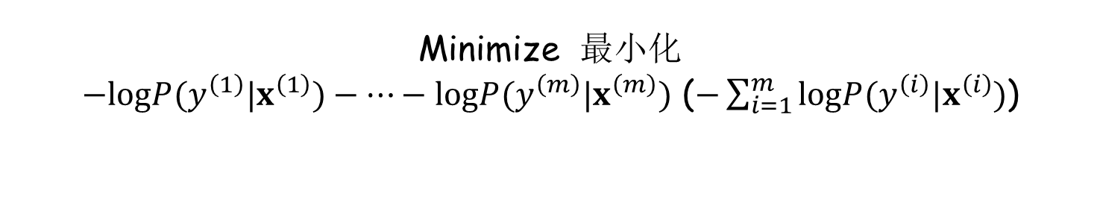
Transformation 变换
$$P(y^{\left(1\right)}|x^{\left(1\right)})×P(y^{\left(2\right)}|x^{\left(2\right)})×…×P(y^{\left(m\right)}|x^{\left(m\right)})$$
Can be very close to 0 given a large $m$
当$m$很大时可能会非常接近于0
We do a transformation using the logarithm function
我们用对数函数作一个变换
Maximize 最大化
$P(y^{\left(1\right)}|x^{\left(1\right)})×…×P(y^{\left(m\right)}|x^{\left(m\right)})$ ($\prod_{i=1}^{m}{P(y^{\left(i\right)}|x^{\left(i\right)})}$)
Then equivalent to 于是等价于
Minimize 最小化
$−logP(y^{\left(1\right)}|x^{\left(1\right)})−…−logP(y^{\left(m\right)}|x^{\left(m\right)})$ ($−\sum_{i=1}^{m}{logP(y^{\left(i\right)}|x^{\left(i\right)})}$)

Slide 14


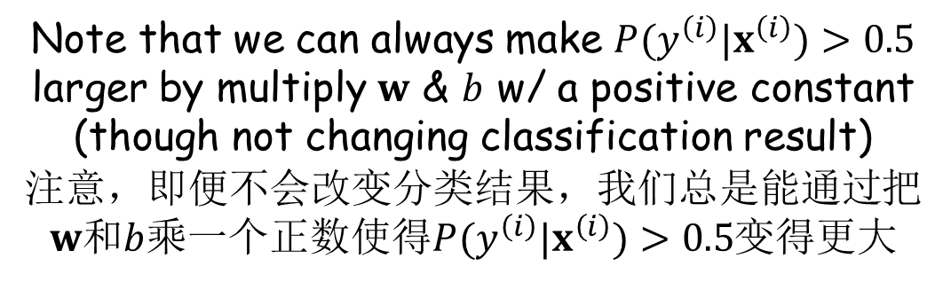
Regularization 调整
Note that we can always make $P(y^{\left(i\right)}|x^{\left(i\right)})>0.5$ larger by multiply $w$ & $b$ w/ a positive constant (though not changing classification result)
注意，即便不会改变分类结果，我们总是能通过把$w$和$b$乘一个正数使得$P(y^{\left(i\right)}|x^{\left(i\right)})>0.5$变得更大
$$P\left(y=1 | x\right)$$
$$w∙x+b$$
Now we do a regularization to penalize large magnitude of $w$ 现在我们作一个调整，来惩罚大幅度的$w$
Minimize 最小化
$$−\sum_{i=1}^{m}{logP(y^{\left(i\right)}|x^{\left(i\right)})}+\frac{λ}{2}{\left\|w\right\|}^{2}$$
Regularization term
调整项

Slide 15
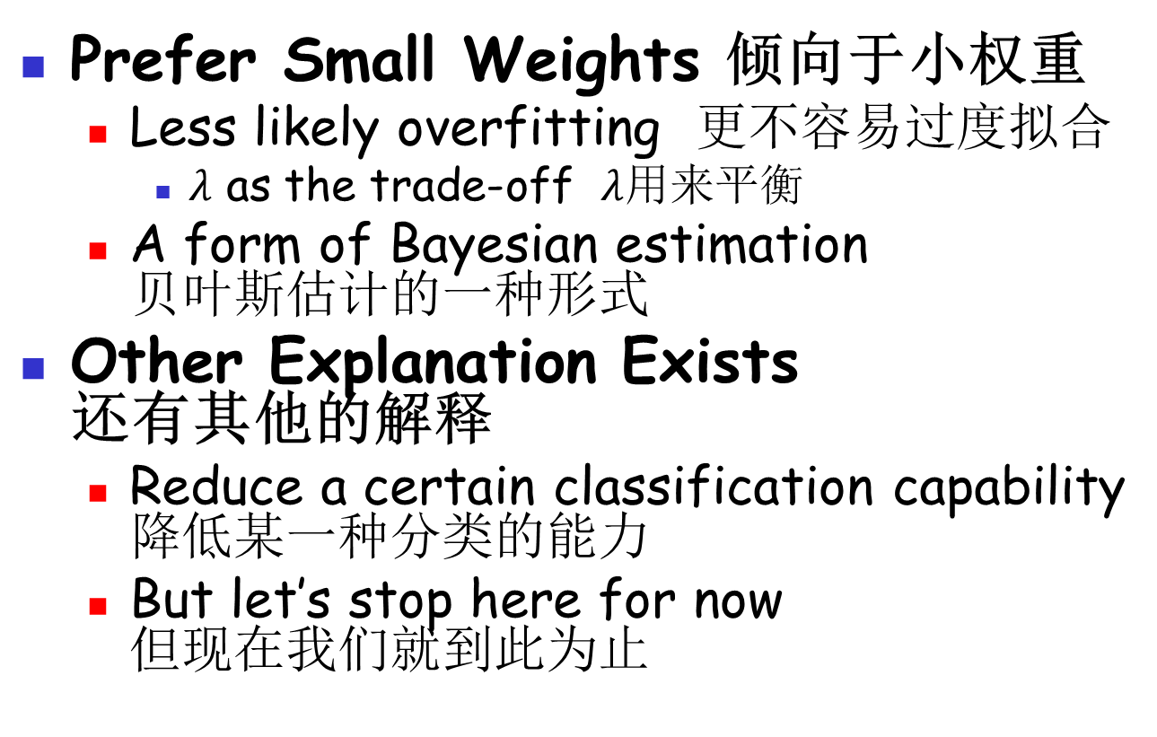
Rationale Behind Regularization 调整的根本原因
Prefer Small Weights 倾向于小权重
  Less likely overfitting 更不容易过度拟合
    $λ$ as the trade-off $λ$用来平衡
  A form of Bayesian estimation
  贝叶斯估计的一种形式
Other Explanation Exists
还有其他的解释
  Reduce a certain classification capability
  降低某一种分类的能力
  But let’s stop here for now
  但现在我们就到此为止

Slide 16
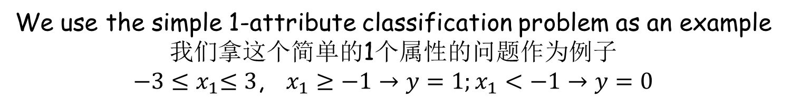

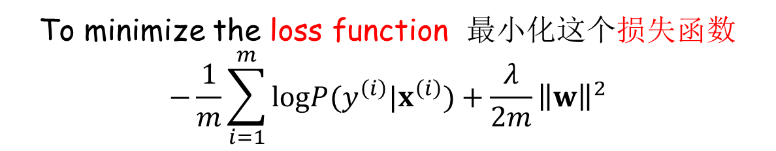
Problem of Learning 学习问题
Find 找到
$w$ & $b$
To minimize the loss function 最小化这个损失函数
$$−\frac{1}{m}\sum_{i=1}^{m}{logP(y^{\left(i\right)}|x^{\left(i\right)})}+\frac{λ}{2m}{\left\|w\right\|}^{2}$$
How to solve the problem? 怎么解这个问题？
We use the simple 1-attribute classification problem as an example 我们拿这个简单的1个属性的问题作为例子
${−3≤x}_{1}≤3$, $x_{1}≥−1→y=1;x_{1}<−1→y=0$

Slide 17
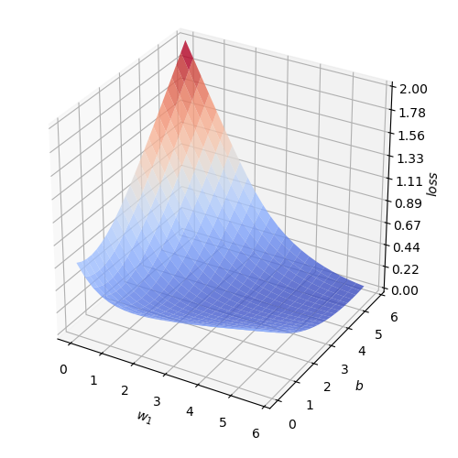
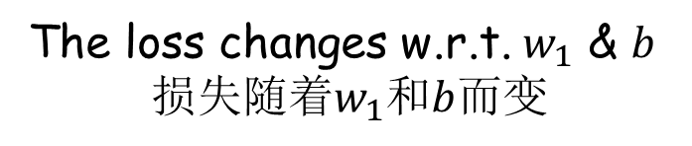
How to Learn 如何学习
The loss changes w.r.t. $w_{1}$ & $b$
损失随着$w_{1}$和$b$而变
Minimum around here
最小值在这里附近

Slide 18
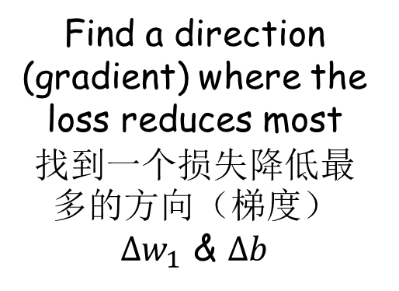
How to Learn 如何学习
Solution: gradient descent
解决方法：梯度下降
Start from here
从这里开始
Find a direction (gradient) where the loss reduces most
找到一个损失降低最多的方向（梯度）
$Δw_{1}$ & $Δb$

Slide 19

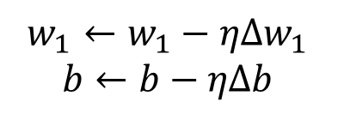
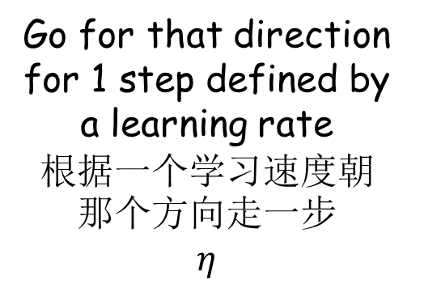
How to Learn 如何学习
Solution: gradient descent
解决方法：梯度下降
Go for that direction for 1 step defined by a learning rate
根据一个学习速度朝那个方向走一步
$$η$$
$$w_{1}←w_{1}−ηΔw_{1}$$
$$b←b−ηΔb$$

Slide 20
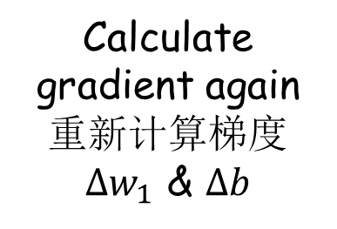
How to Learn 如何学习
Solution: gradient descent
解决方法：梯度下降
Calculate gradient again
重新计算梯度
$Δw_{1}$ & $Δb$

Slide 21

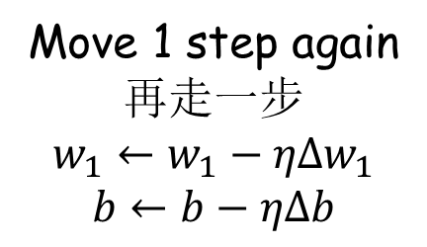
How to Learn 如何学习
Solution: gradient descent
解决方法：梯度下降
Move 1 step again
再走一步
$$w_{1}←w_{1}−ηΔw_{1}$$
$$b←b−ηΔb$$

Slide 22








How to Learn 如何学习
Solution: gradient descent
解决方法：梯度下降
Repeat the process
重复该过程
Stop if the change of loss becomes too small
当损失变化非常小的时候终止

Slide 23
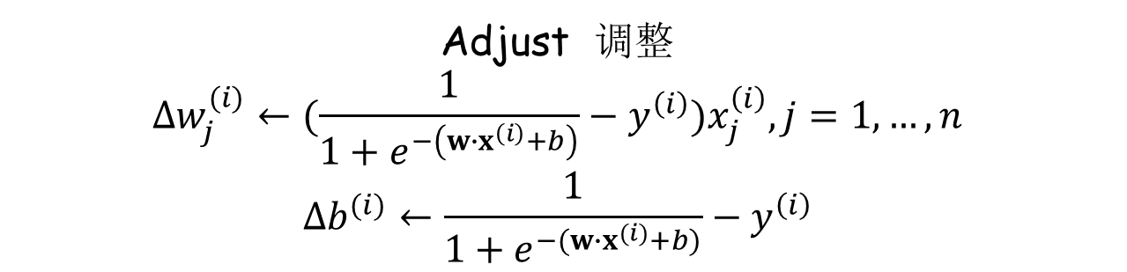
Gradient Calculation 梯度计算 (1)
For one sample 对一个数据 $(x^{\left(i\right)},y^{\left(i\right)})$
Use the current 用当前的 $w$ & $b$
We get 我们得到 $P(y=1|x^{(i)})=\frac{1}{1+e^{−(w∙x^{(i)}+b)}}$
Compare the probability w/ 拿这个概率对比 $y^{\left(i\right)}$
We get 我们得到 $\frac{1}{1+e^{−(w∙x^{(i)}+b)}}−y^{\left(i\right)}$
Adjust 调整
$$Δw_{j}^{(i)}←(\frac{1}{1+e^{−\left(w∙x^{\left(i\right)}+b\right)}}−y^{\left(i\right)})x_{j}^{\left(i\right)},j=1,…,n$$
$$Δb^{(i)}←\frac{1}{1+e^{−(w∙x^{(i)}+b)}}−y^{\left(i\right)}$$

Slide 24
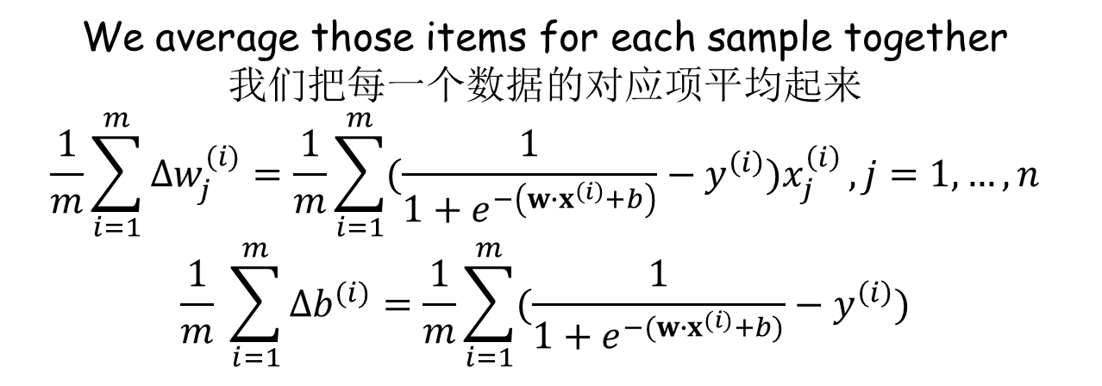
Gradient Calculation 梯度计算 (2)
We have 我们有 $(x^{\left(1\right)},y^{\left(1\right)}),(x^{\left(2\right)},y^{\left(2\right)}),…,(x^{\left(m\right)},y^{\left(m\right)})$
We average those items for each sample together
我们把每一个数据的对应项平均起来
$$\frac{1}{m}\sum_{i=1}^{m}{Δw_{j}^{(i)}}=\frac{1}{m}\sum_{i=1}^{m}{(\frac{1}{1+e^{−\left(w∙x^{\left(i\right)}+b\right)}}−y^{\left(i\right)})x_{j}^{\left(i\right)}},j=1,…,n$$
$$\frac{1}{m} \sum_{i=1}^{m}{Δb^{(i)}}=\frac{1}{m}\sum_{i=1}^{m}{(\frac{1}{1+e^{−(w∙x^{(i)}+b)}}−y^{\left(i\right)})}$$

Slide 25

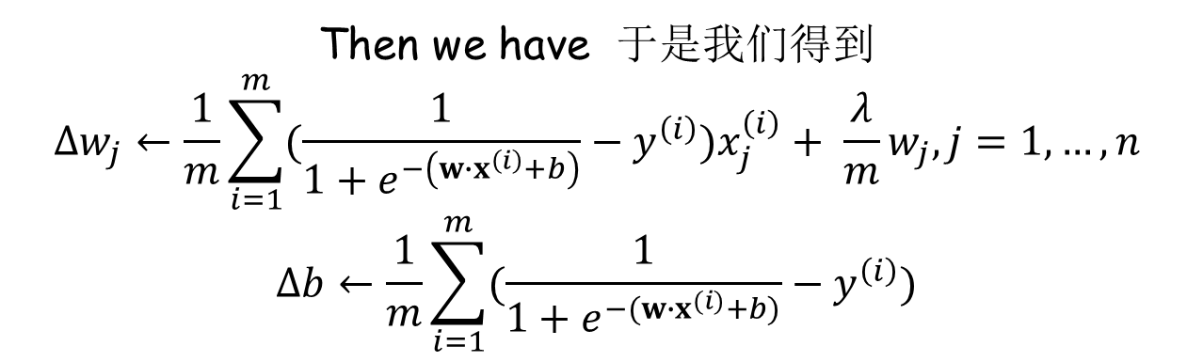
Gradient Calculation 梯度计算 (3)
Finally we consider regularization 最后我们考虑调整项
$$\frac{λ}{m}w_{j}$$
Then we have 于是我们得到
$$Δw_{j}←\frac{1}{m}\sum_{i=1}^{m}{(\frac{1}{1+e^{−\left(w∙x^{\left(i\right)}+b\right)}}−y^{\left(i\right)})x_{j}^{\left(i\right)}}+ \frac{λ}{m}w_{j},j=1,…,n$$
$$Δb←\frac{1}{m}\sum_{i=1}^{m}{(\frac{1}{1+e^{−(w∙x^{(i)}+b)}}−y^{\left(i\right)})}$$

Slide 26

Practice 8.1 实践8.1
Practice time: try logistic regression on the example
实践时刻：在这个例子上尝试对数几率回归

Slide 27
We Now Know 我们现在了解了
A New Algorithm 一个新的算法
  To learn linear classifiers
  用以学习线性分类器
Where Is the Relevance w/ Margin?
和间距的相关性在哪里？
  Recall margin as some sort of confidence
  记得间距是一种置信度
  Logistic regression outputs a probability
  对数几率回归给出了概率

Slide 28
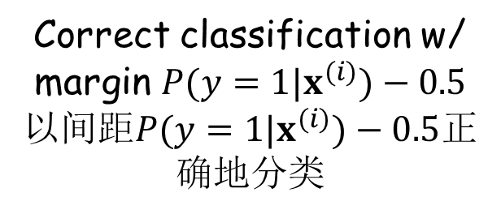

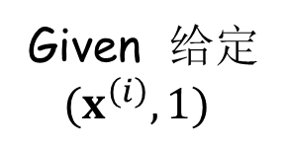
An Alternative Margin
别样的间距
Given 给定
$(x^{\left(i\right)},1)$
1
$$P(y=1|x^{(i)})$$
Correct classification w/ margin $P(y=1|x^{(i)})−0.5$
以间距$P(y=1|x^{(i)})−0.5$正确地分类
0.5
0

Slide 29
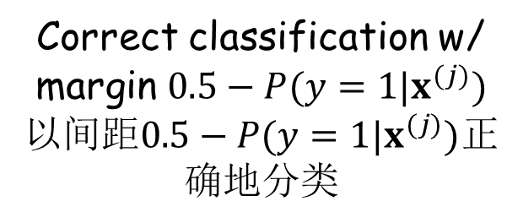

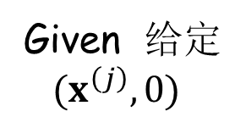
An Alternative Margin
别样的间距
Given 给定
$(x^{\left(j\right)},0)$
1
Correct classification w/ margin $0.5−P(y=1|x^{(j)})$
以间距$0.5−P(y=1|x^{(j)})$正确地分类
0.5
0
$$P(y=1|x^{(j)})$$

Slide 30

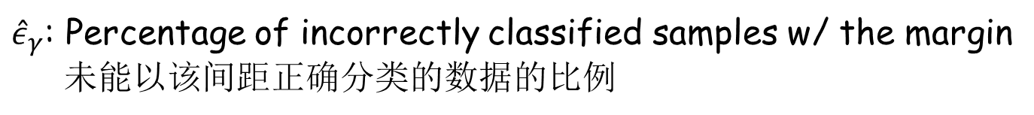

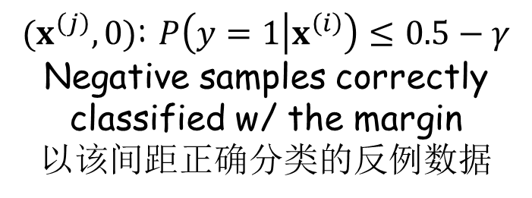
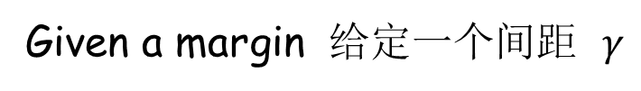
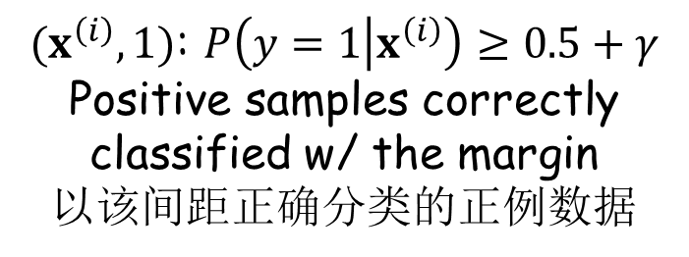


An Alternative Margin
别样的间距
Given a margin 给定一个间距 $γ$
$(x^{\left(i\right)},1)$: $P\left(y=1 | x^{\left(i\right)}\right)≥0.5+γ$
Positive samples correctly classified w/ the margin
以该间距正确分类的正例数据
1
$$0.5+γ$$
$$γ$$
0.5
$(x^{\left(j\right)},0)$: $P\left(y=1 | x^{\left(i\right)}\right)≤0.5−γ$
Negative samples correctly classified w/ the margin
以该间距正确分类的反例数据
$$γ$$
$$0.5−γ$$
0
${\hat{ε}}_{γ}$: Percentage of incorrectly classified samples w/ the margin
未能以该间距正确分类的数据的比例

Slide 31
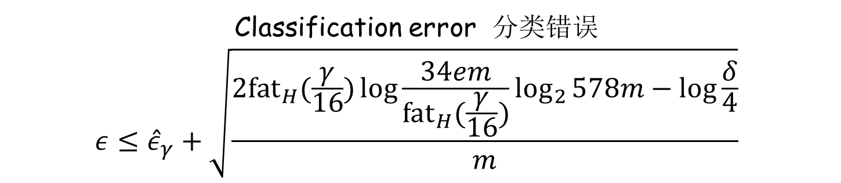
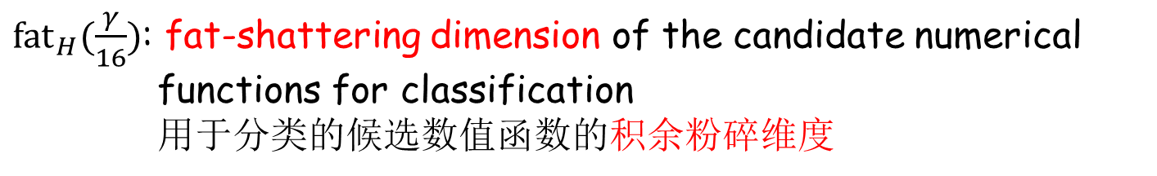

Math Theorem 数学定理
$m$: number of training samples 训练数据数量
${fat}_{H}(\frac{γ}{16})$: fat-shattering dimension of the candidate numerical functions for classification
用于分类的候选数值函数的积余粉碎维度
$δ$: tolerance of probability of unluckiness 能忍受的运气不好的概率
Classification error 分类错误
$$ε≤{\hat{ε}}_{γ}+\sqrt{\frac{2{fat}_{H}(\frac{γ}{16})\log{\frac{34em}{{fat}_{H}(\frac{γ}{16})}}\log_{2}{578m}−log\frac{δ}{4}}{m}}$$
Except for the probability $δ$ of unluckiness
除去概率为$δ$的运气不好的情况

Slide 32
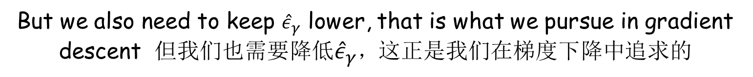


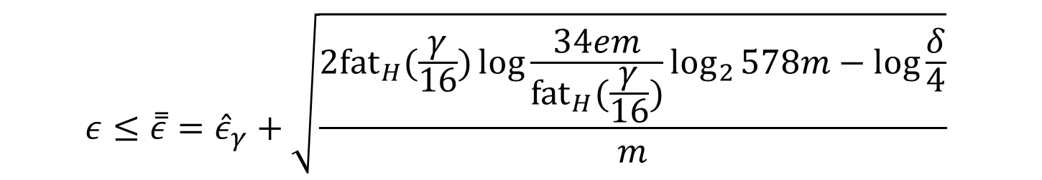
Upper Bound of Error 错误上界
$$ε≤\overset{̿}{ε}={\hat{ε}}_{γ}+\sqrt{\frac{2{fat}_{H}(\frac{γ}{16})\log{\frac{34em}{{fat}_{H}(\frac{γ}{16})}}\log_{2}{578m}−log\frac{δ}{4}}{m}}$$
In logistic regression 在对数几率回归中
$${fat}_{H}(\frac{γ}{16})≤\frac{cn}{γ^{2}}\log{\frac{16}{γ}}$$
Larger margin $γ$ → likely lower ${fat}_{H}(\frac{γ}{16})$ → likely lower $\overset{̿}{ε}$
更大的间距$γ$ → 可能获得更低的${fat}_{H}(\frac{γ}{16})$ → 可能获得更低的的$\overset{̿}{ε}$
But we also need to keep ${\hat{ε}}_{γ}$ lower, that is what we pursue in gradient descent 但我们也需要降低${\hat{ε}}_{γ}$，这正是我们在梯度下降中追求的

Slide 33
Practice 8.2 实践8.2
Practice time: try logistic regression on word sense disambiguation
实践时刻：将对数几率回归用于词义消歧
How does it perform? 它的表现如何？

Slide 34
Result 结果
Methods 方法 | Accuracy 准确率
Nearest neighbor 最近邻 | 69.3%
Perceptron 感知器 | 83.6%
Perceptron w/ margin 带间距的感知器 | 85.7%
Logistic regression 对数几率回归 | 85.0%

Slide 35
The End

